Slide 1

Mobile Application Development, Fall 2021 Introduction to Components

Slide 2
Today’s Agenda
What is a Component? / Structure of a Component
The Grand Component Challenge!
Getting a Custom Component to Show Up
A Second Challenge!
A Little More About JSX
The Final Challenge

Slide 3
What is a Component?
A component in React Native is a reusable bit of code that displays something to a screen.
A component can be an entire screen unto itself.
It can be just a small piece of a larger screen.
Basically: anything you ever SEE in a react native app is gonna be some kinda component.
The HomeScreen.js file from the boiler plate code was an example of a component file!
It specified a single component used up the whole screen!
Component files create and export exactly one React Component.

Slide 4
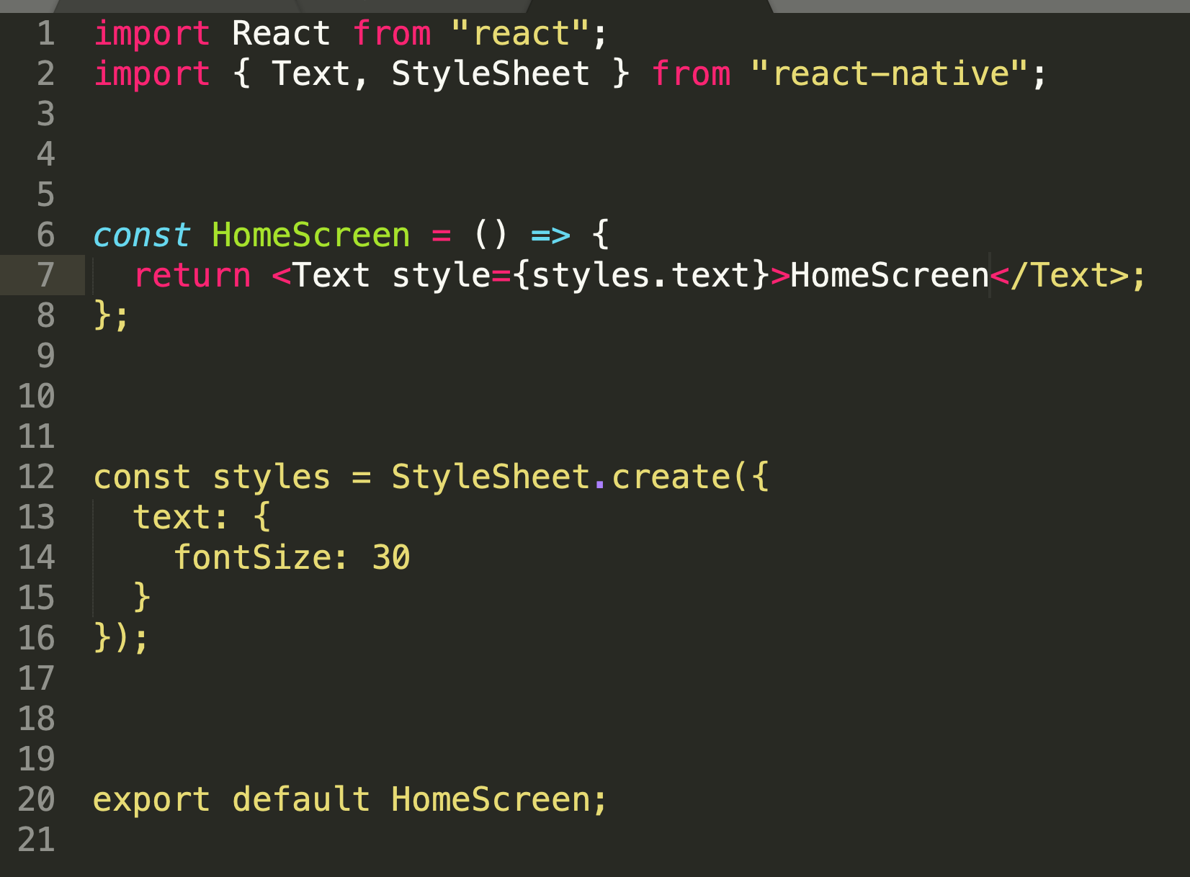
Structure of a Component.
Components have four parts
Part 1
Importing the libraries our component needs
Part 2
Creating the component itself (a function that returns JSX)
Part 3
Creating a stylesheet to customize how our component looks
Part 4
Exporting our component so it can be used elsewhere in our project

Slide 5
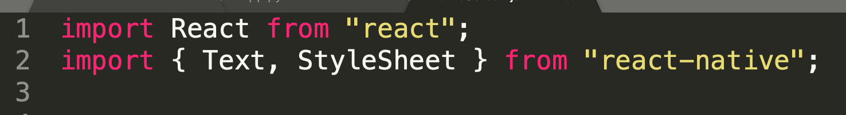
Structure of a Component – Import Statements
Here, “react” and “react-native” are libraries (sometimes called packages).
You may have noticed how line 2 has curly braces but line 1 doesn’t.
Line 1 is importing everything from the “react” library.
Line 2 is only importing Text and StyleSheet from the “react-native” library.
The “react” library has a ton of components that know how to work together already inside of it.
“react-native” knows how to display those components on mobile devices.

Slide 6
Structure of a Component – Import Statements
Slightly more specifically…
An import statement *without* curly braces (e.g., line 1) means you are importing whatever has been labelled as the default export from the library.
And when you have curly braces (e.g., line 2) that means you are importing specific variables/functions/classes/objects/etc. that have been labelled as export from the library.
Here is a nice resource on importing and exporting:
https://www.digitalocean.com/community/tutorials/understanding-modules-and-import-and-export-statements-in-javascript

Slide 7
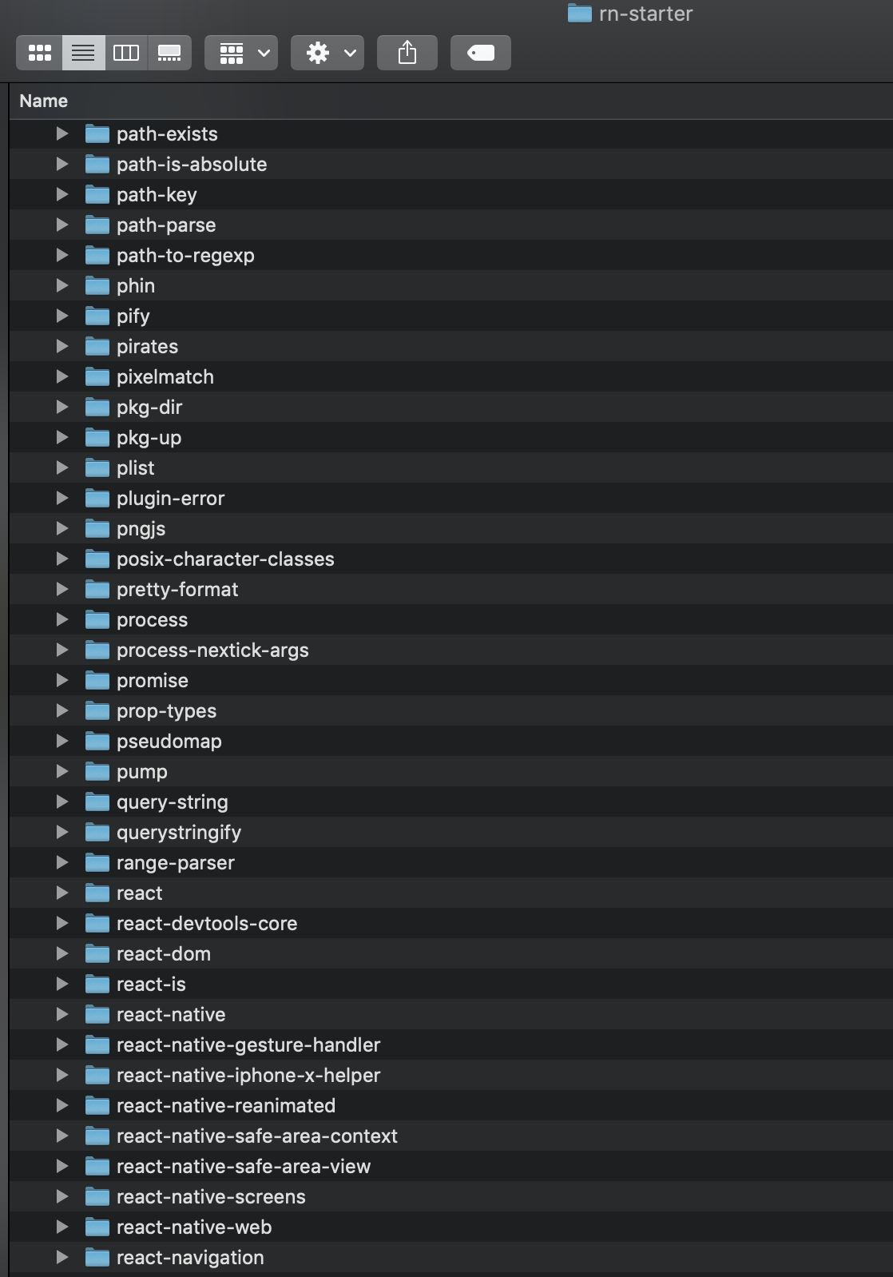





Structure of a Component – Import Statements
Also, FYI, we “have these” because of that ‘npm install’ command we entered when setting everything up. These packages were specified as dependencies for our project in package.json
You can see them both in your node_modules folder!

Slide 8


Structure of a Component.
Components have four parts
Part 1
Importing the libraries our component needs
Part 2
Creating the component itself (a function that returns JSX)
Part 3
Creating a stylesheet to customize how our component looks
Part 4
Exporting our component so it can be used elsewhere in our project

Slide 9
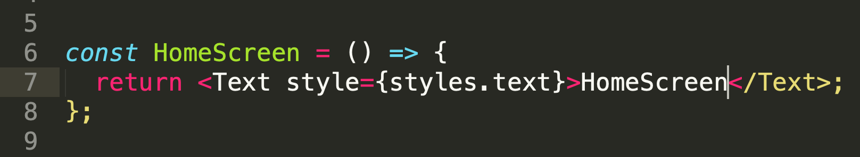
Structure of a Component.
The second part is a function that returns JSX. Though the whole file is our Component File, this part truly is our component.
For those of you less familiar with JavaScript, in JavaScript, functions are First Class Objects. That means we can store functions inside of variables. It means other things too, but that’s fine for now!
So that’s what’s going on here!

Slide 10
Structure of a Component.
The const HomeScreen declares a new variable called HomeScreen
Again, for those of you unfamiliar with JavaScript, note we don’t specify a type, e.g., “int” or “string” or “float” – welcome to the weakly typed world of JavaScript land!
The = is, as always, the assignment operator, so we are assigning HomeScreen a value.
But the value we are giving it IS a function!
The () represent the parameter list (here, it’s empty).
And everything between the { } is the function body.

Slide 11
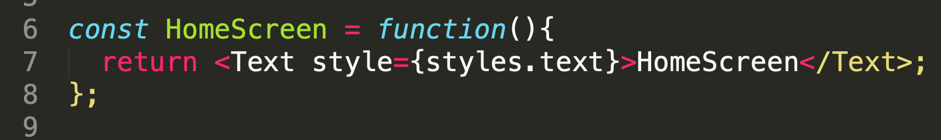


Structure of a Component.
These are two equivalent things you can do!
The top style, the “arrow function” way of declaring a function, is kind of hip and trendy and new, and lots of people think it looks cleaner.
The bottom style, the “keyword function” way of declaring a function, is more traditional and some people (like me) find comfort in tradition and think the arrow style is strange and scary.
Either will work just fine! It’s good to be familiar with both!

Slide 12
Structure of a Component.
What we are returning is an example of JSX.
Stands for JavaScript XML
It is certainly *reminiscent* of HTML, but is *different* from it for sure.
We’ll chat more about JSX soon, but for now, just know that what we are returning here is the contents of our component.
Specifically, we are returning…
A Text component (also often referred to as a Text element)….
Whose style is defined by styles.text
And whose content will be the text “HomeScreen”

Slide 13
Structure of a Component.
Components have four parts
Part 1
Importing the libraries our component needs
Part 2
Creating the component itself (a function that returns JSX)
Part 3
Creating a stylesheet to customize how our component looks
Part 4
Exporting our component so it can be used elsewhere in our project

Slide 14
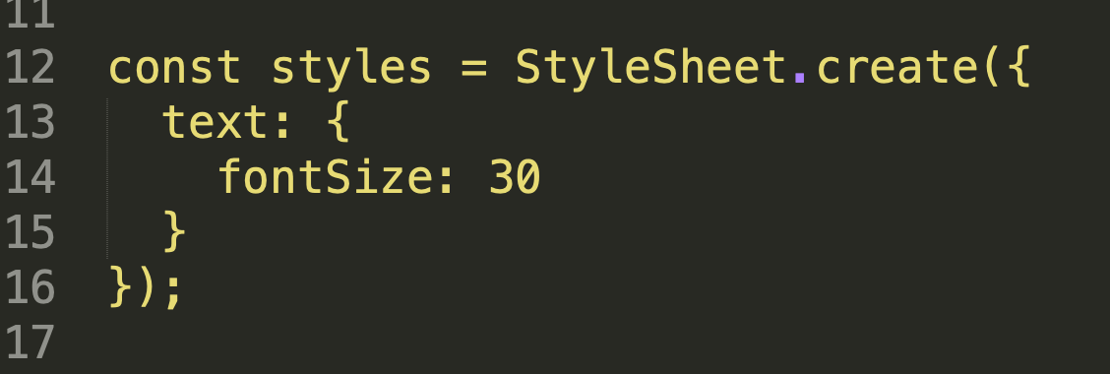
Structure of a Component.
This is us creating a style sheet! For those of you familiar with web development and CSS, the idea is pretty much the same!
In short, this will help us specify the style of our components. i.e., how we want them to look!
Let’s break it down bit by bit again…

Slide 15

Structure of a Component.
Once again, we are declaring a variable of our own, called “styles” and assigning it a value.
The StyleSheet.create(…) is us calling the create function from the StyleSheet library that we imported back in step 1.

Slide 16

Structure of a Component.
The function takes in a JavaScript object as input, that specifies the stylesheet itself.
As another quick aside for those unfamiliar with JavaScript: objects in JavaScript are *very* versatile and flexible. Let’s say you wanted to create an object with two fields, age and name, and store that object in a variable person, you could do it just like this:
Just a comma separated list of name : value pairs, with each pair separated by a comma, enclosed in curly braces.
const person = {
age : 27,
name : “Billy Bob”
}
Can access things via the dot operator. E.g.:
person.age; //would be 27

Slide 17

Structure of a Component.
So the red part circled right here is just ONE key-value pair. The key is text and the value is… another object!

Slide 18


Structure of a Component.
So the red part circled right here is just ONE key-value pair. The key is text and the value is… another object!
That “inner” object is circled in blue. It itself also has only one key-value pair. The key here is fontSize and the value is the number 30

Slide 19
Structure of a Component.
In this example, the word text has no special significance. Our stylesheet can have a lot of variables inside of it, and we can give them any name we want. Descriptive names are, of course, always helpful. Giving it the name text implies we’re about to specify style information for text elements.
fontSize however, is NOT up to us – there are very specific terms to use to specify style properties.

Slide 20
Structure of a Component.
For those familiar with CSS – all the same things you can use there you should be able to use here -- with the notable exception that React Native style properties are written in camelCase and not hyphens.
i.e., here, it is fontSize. In traditional CSS, it would be font-size
There’s a lot out there, so definitely play around with it! Here’s some styling documentation: https://reactnative.dev/docs/text-style-props

Slide 21
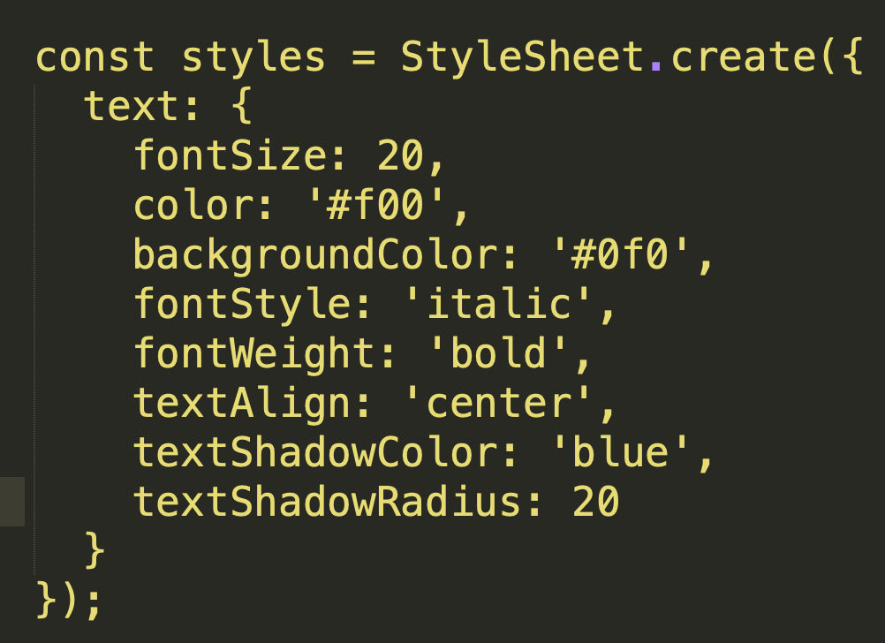
Structure of a Component.
If you want to have multiple properties be styled, just separate them with commas (again, don’t forget, you’re making an object here!)
What do you think this style would end up looking like?

Slide 22



Structure of a Component.
Components have four parts
And we can see how part 2 and part 3 are connected!
When we wrote styles.text on line 7, that’s us asking for the value of the ‘text’ property of our styles object.
Which we can see in this example just sets the fontSize property to 30, but could in theory include any number of additional style changes.

Slide 23


Structure of a Component.
Components have four parts
Part 1
Importing the libraries our component needs
Part 2
Creating the component itself (a function that returns JSX)
Part 3
Creating a stylesheet to customize how our component looks
Part 4
Exporting our component so it can be used elsewhere in our project

Slide 24
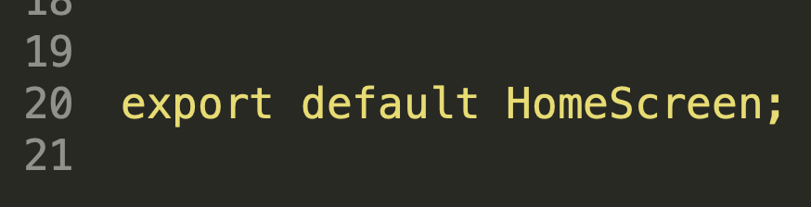
Structure of a Component.
This last part is nice and simple!
The upshot: this is what will allow us to use our HomeScreen component in other parts of our project.
The keywords/variables at play here:
export – what makes this “importable” in other parts of our code.
default – If we import without specifying anything with { }, this is what we’ll get.
HomeScreen - the thing we’re exporting. Here, our variable that is storing our function that returns the JSX that makes up our component.

Slide 25
Structure of a Component.
Components have four parts
Part 1
Importing the libraries our component needs
Part 2
Creating the component itself (a function that returns JSX)
Part 3
Creating a stylesheet to customize how our component looks
Part 4
Exporting our component so it can be used elsewhere in our project

Slide 26
The Grand Component Challenge!
We’re going to budget a few minutes for YOU to make your very first component! Your component should have the following properties:
It should live in the same ‘src/screens’ folder as HomeScreen.js
It should be called “ComponentsScreen.js”
It should import React from the react library, and Text and StyleSheet from the react-native library.
The component should consist of a styled text element that says something like “This is the components screen” (exact text doesn’t matter. Have fun!)
It can be styled in any way you want, as long as the fontSize is specified.
It should be the default export, like we saw in HomeScreen.js
Try challenging yourself and NOT copying and pasting anything from HomeScreen! Try to make it from scratch!
GOOD LUCK HAVE FUN!

Slide 27
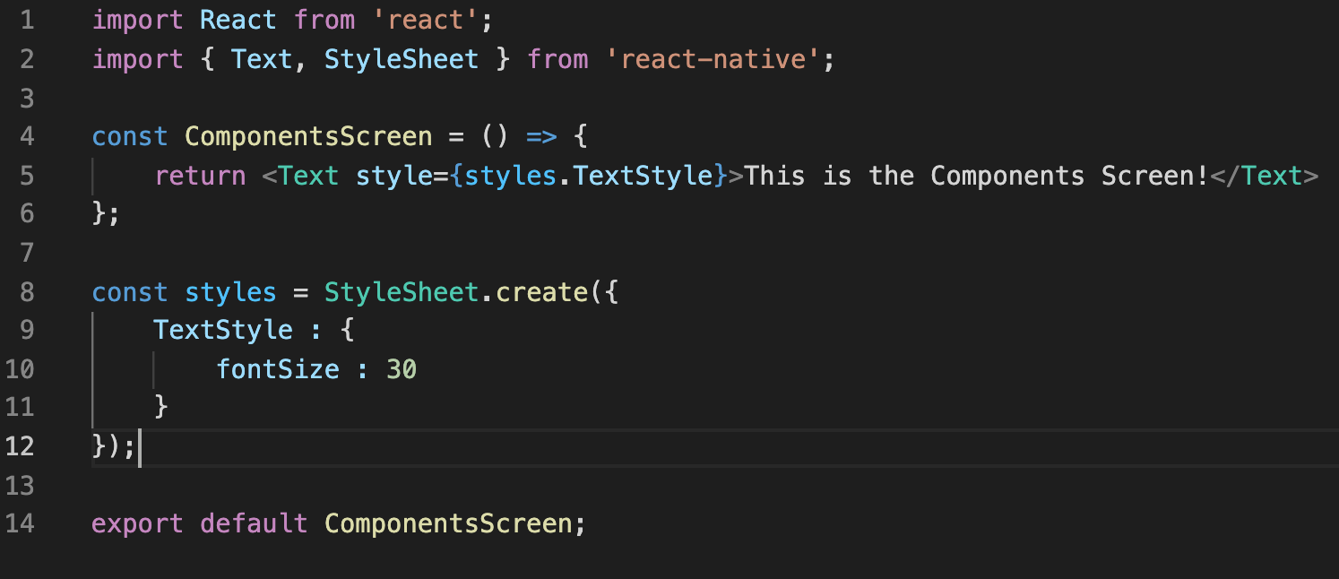
Component Challenge!
You probably ended up with something like this, right? Also, I changed editors mid-way through making slides. Pay no attention to the change in syntax highlighting!

Slide 28
Today’s Agenda
What is a Component? / Structure of a Component
The Grand Component Challenge!
Getting a Custom Component to Show Up
A Second Challenge!
A Little More About JSX
The Final Challenge

Slide 29
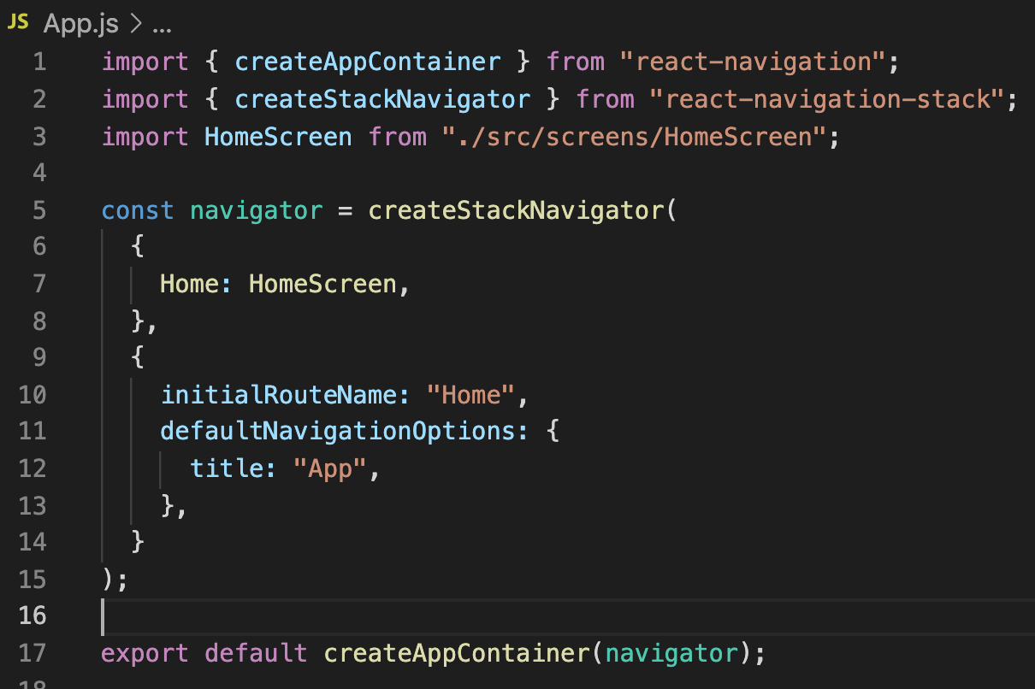
Getting our Custom Component to Show Up
So, just making a new component in a new file alone isn’t enough to get it to show up on our device.
We need to teach our app that it exists! We’ll do that by checking out and modifying our App.js file!

Slide 30



Getting our Custom Component to Show Up
Even though this is a brand new file, we can see it already has some of the same ideas as what we were just looking at!
We import things!
We make a thing (here something we call a navigator)
Then we export that thing we made!

Slide 31




Getting our Custom Component to Show Up
Some particular things to note:
We import HomeScreen – that’s one of OUR components, not something from react!
When creating our navigator object, we create a key-value pair, linking the key Home to HomeScreen
Setting initialRouteName is how we specify what our “starting screen” is when we launch our app.

Slide 32
The Second Challenge!
So with that, a second challenge!
EDIT this file, so that the start screen when launching your app is that new ComponentsScreen that we just made together!

Slide 33
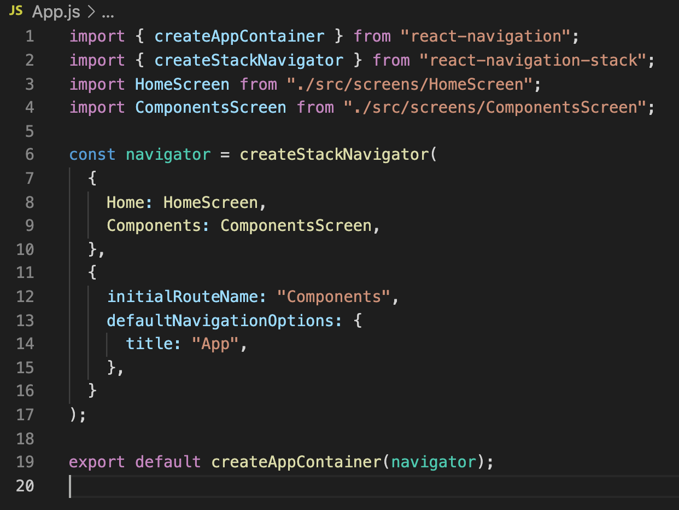


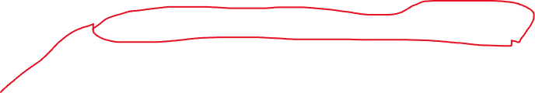
It probably looks something like this, right?
We need to import our ComponentsScreen
The “.” at the beginning of the path means “the current directory” – these are relative paths.
We add the ComponentsScreen to the list of things we might be able to show.
We say that we should “start” at the screen specified by Components.

Slide 34
We’ll chat more about this file and navigation later!
For now, we can be happy that we know how to display different hand-crafted screens to our devices!

Slide 35
Today’s Agenda
What is a Component? / Structure of a Component
The Grand Component Challenge!
Getting a Custom Component to Show Up
A Second Challenge!
A Little More About JSX
The Final Challenge

Slide 36
A Little More about JSX
We’ll be chatting about JSX all semester long! So today is just a gentle introduction, and is by no means fully comprehensive.
So, we hopefully recall that this was an example of JSX (specifically what was being returned):

Slide 37
A Little More about JSX
The Text element is an example of a React Native Primitive.
The StyleSheet we made was one too!
Other Primitives include…
View: A container for other components! Think like a “<div>” tag in web dev!
Image: Displays an image!
Button: Make something happen when you click on it!
And many others! Important: Make sure you import them if you want to use them!

Slide 38
A Little More about JSX
You might also be wondering, what is the relationship between JSX and react native?
WELL… as I’ve said, JSX and JavaScript are different – and they are! The React Bundler that we are using (the Metro Bundler) uses something called Babel.js to translate JSX into plain ol’ JavaScript.
We can see this for ourselves first hand at: https://babeljs.io/ (click “Try It Out”).

Slide 39
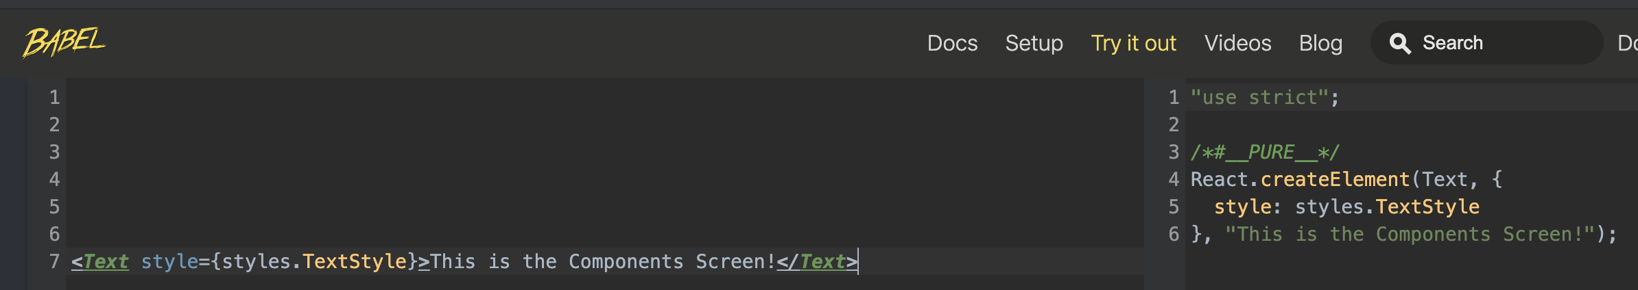


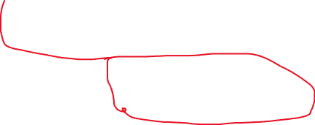
A Little More about JSX
When you type JSX on the left, you get the regular JavaScript it translates into on the right.
Looking at the right, you can see that our JSX translates into invoking the “createElement” method from the React library we imported!
Hence why we needed to import it, even though we never referenced it directly in our code!
So, why JSX instead of just React.createElement directly?
Generally speaking, JSX is easier to read! And thus easier to modifier!

Slide 40





A Little More about JSX
Those of you familiar with HTML know that you can nest elements within each other:
<div>
I am the outermost Content!
<div>
I am an inner div!
<div>
I am even more inner, still!
<span>I’m as inner as it gets!</span>
</div>
</div>
</div>
Opening tags (almost always) get matched with closing tags.
Everything between the opening and closing tag is inside the tag.

Slide 41
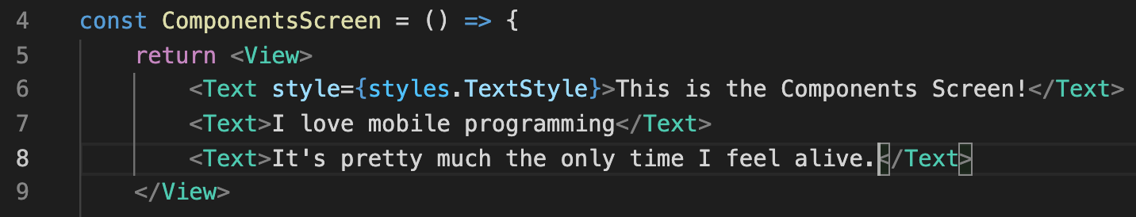
A Little More about JSX
The same is true in JSX! BUT one important caveat: you can only have one “parent” element.
That means that the following is fine:
Because it only has ONE parent element (the View) (also sometimes called “top level element”).
And then nested within the View are three Text elements.
Which is totally great! Go bananas! Nest as many elements as you wish!
Again, just make sure you import View from the react-native library before you use it!

Slide 42
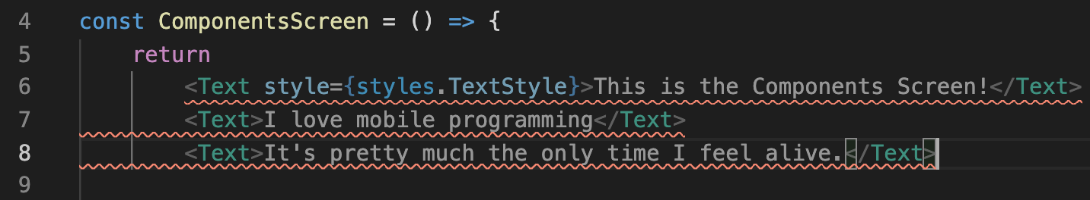
A Little More about JSX
But this seemingly innocent code would NOT be fine:
Even though it *feels* like it’s basically doing the same thing…
INSTEAD of having one parent element that contained three nested Text elements like before…
THIS example has three “top level” elements. None of these text’s are “within” each other, they are all at the same level. And as we just said, you can only have ONE top level element.

Slide 43
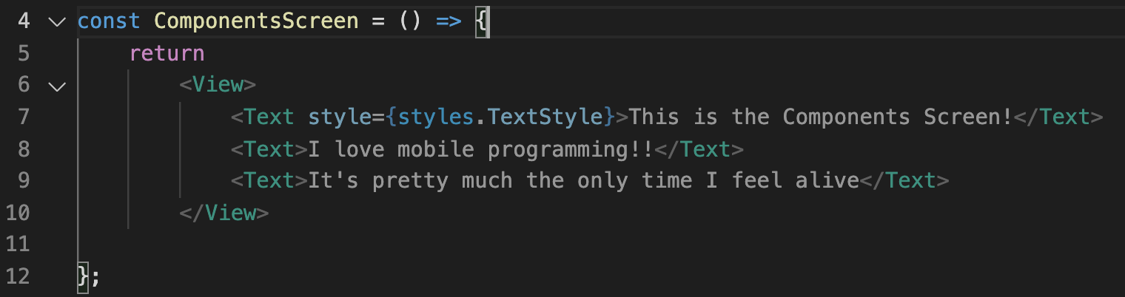
A Little More about JSX
And believe it or not, this wouldn’t be fine either!:
Here we DO only have one top level element…
But it is defined on line 6, and the return statement is on line 5!
This makes React Native sad, and think you aren’t returning anything.
So you need to make sure the return keyword and the top level element are on the same line.

Slide 44
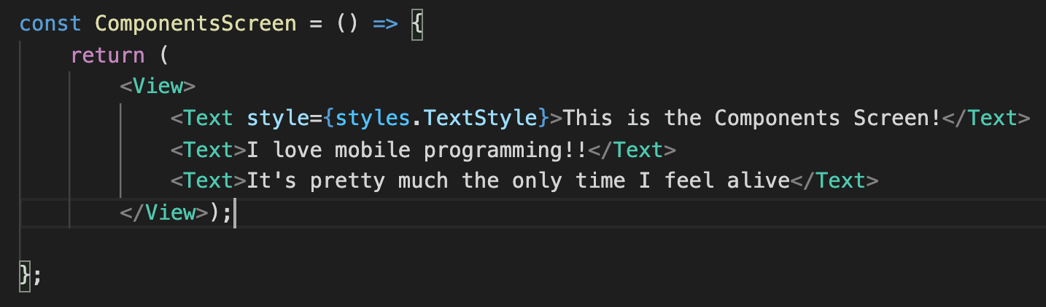


A Little More about JSX
Alternatively….
You can put the whole thing in parenthesis, and now your top level element can be on the next line.
At this point, it’s just matter of cosmetics and personal preference! It’s an “opening curly brace on the same line or the next line’ situation.

Slide 45

A Little More about JSX
Another notion that we’ll be discussing a lot through the semester is the concept of props.
The short-hand, cool way of saying properties.
React Native components can be customized / parametrized / configured with different props.
Components that we use, built from others, have very specific props that we can leverage (e.g., the “style” prop of the Text element).
But soon we’ll be making our own components with their own custom props!

Slide 46



A Little More about JSX
You also (maybe?) were wondering what the deal was with the curly braces inside of the JSX here:
The basic upshot: you use curly braces in JSX when you want to refer to / access a JavaScript variable.

Slide 47
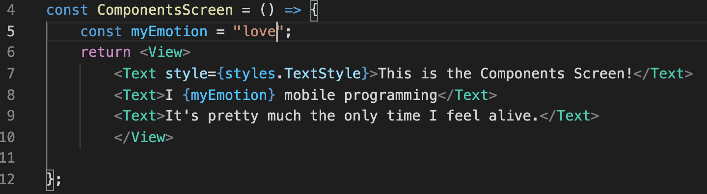

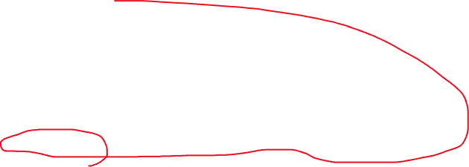
A Little More about JSX
So if we take this slightly revised version of that code…
We see we declare a local variable inside of our function here on line 5….
And then use it over here on line 8…
It’ll work as you expect!
i.e., in this example, It would display “I love mobile programming”

Slide 48
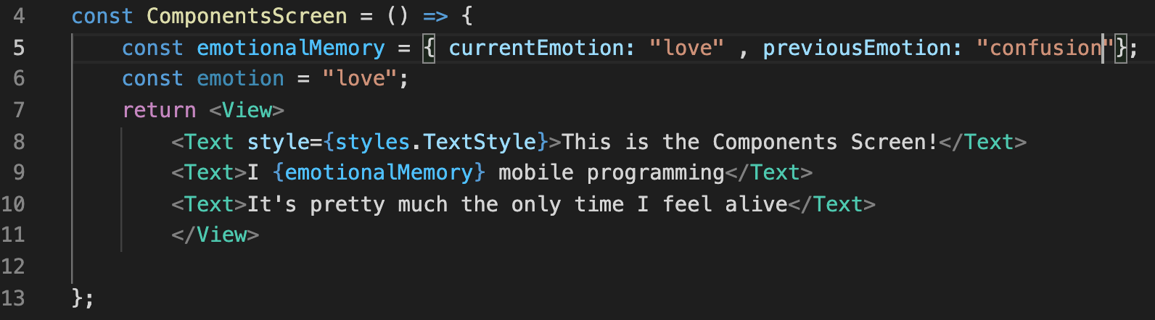
A Little More about JSX
That works for *most* variables
E.g., strings, numbers, arrays
But it notably *doesn’t* work for objects.
The following would get you an error -- because “Objects are not valid as a React child”
Note how we declare emotionalMemory to be an object, and then just try to print it out in Text.

Slide 49
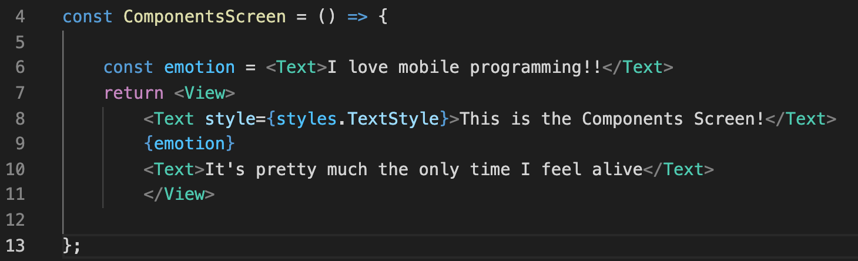

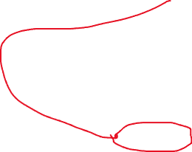

A Little More about JSX
But it *Does* work for JSX! The following would be just fine!
Note how it has a variable (emotion) that has JSX tags in it.
And then we access it using the { } like it’s no big deal!

Slide 50
A Little More about JSX
It’s basically the same thing, but now gives us a little bit more flexibility.
For example, now we can have functions/logic/etc. that returns strings with JSX in it! We can procedurally generate it based on application state!
That’s pretty helpful!

Slide 51
Today’s Agenda
What is a Component? / Structure of a Component
The Grand Component Challenge!
Getting a Custom Component to Show Up
A Second Challenge!
A Little More About JSX
The Final Challenge

Slide 52
The Final Challenge
So, by this point, you *definitely* know everything you need in order to do the homework assignment!
So the final challenge of today is: the homework assignment… but BETTER!
Make a New Component.
Give that Component three separate text elements.
Have each of those text elements be styled differently (at minimum change the font sizes, but go wild! https://reactnative.dev/docs/text-style-props).
Try to weave a variable in there, just for practice!
If you’ve already submitted the first assignment, that’s fine, but feel free to reupload this better, cooler version with snazzier graphics, if you are so inclined!

Slide 53
Today’s Agenda
What is a Component? / Structure of a Component
The Grand Component Challenge!
Getting a Custom Component to Show Up
A Second Challenge!
A Little More About JSX
The Final Challenge

